Slide 1
SPIN FELLOWS 2016

Slide 2
Breanna Avery
I accepted a position at Volunteer Lawyers Project of Onondaga County, Inc. (VLP). I obtained a student practice order which allowed me to represent low-income tenants in Syracuse city eviction court. I was able to delay or prevent evictions for our clients, many of whom had children who also would have been without a place to go.
Throughout my three years with SPIN I have been fortunate enough to receive two SPIN fellowships which gave me the opportunity to work for two great organizations and to utilize my skills to raise money for more fellowships. This means that not only have I been able to directly provide legal services to indigent individuals. I cannot express enough the gratitude I have to SPIN for providing me with these wonderful experiences.
Legal Intern, Volunteer Lawyers Project of CNY, Inc
Two Time Spin fellowship Recipient
SPIN Auction Director Assistant

Slide 3
Yolanda Beasley
During my internship, I was able to write a brief and present it in an oral argument; observe and assist in a cold case murder from twenty years ago; and handle about twenty cases a week on my own. All of those opportunities would not have been possible if it was not for the support I received through the Syracuse Public Interest Network (SPIN) fellowship program.
I am grateful to the Syracuse Public Interest Network for providing me with a way to indulge in my childhood dreams of being a prosecutor without having to stress over my finances. If it were not for SPIN, I would have had to balance working 40 hours a week, while working a part-time job to make ends meet. I hope SPIN continues its efforts by supporting those students working within the public interest field and those working to make a difference in people’s lives, one case at a time.
Legal Intern, Virginia Beach Commonwealth's Attorney's Office

Slide 4
Mariam Gaye
As an intern in the Parole Revocation Defense Unit, I was able to obtain a practice order and successfully represent clients at Rikers Island, who were alleged to have committed violations of parole conditions, draft writs of habeas corpus, and conduct legal research relating to parole violations.
I learned a lot about how the parole system works and how it should be reformed, but the best part of my experience was making a direct impact in the lives of low income New Yorkers and giving them a voice in the criminal justice system. Receiving a SPIN fellowship allowed me work with an amazing indigent defense organization and develop the skills necessary to reach my career goal of becoming a public defender.
Legal Intern, Legal Aid Society, Parole Revocation Defense Unit
Fellowship Director

Slide 5
Abdel- Rahman Hamed
This past summer, I completed an internship at the Frauds and Civil Rights Bureaus at the Kings County District Attorney’s Office in Brooklyn, New York. There, I successfully partook in two complex financial investigations and three civil rights cases.
The SPIN Fellowship helped provide me through my placement a nuanced perspective into the financial crimes and civil rights violations that invariably impact communities of color, immigrants and New Americans, and the poor and elderly. Because of the SPIN Fellowship, I have acquired a practice-ready array of skills and experiences.
Legal Intern, Kings County District Attorney’s Office
Financial Director

Slide 6
Lauren Henry
I was lucky enough to spend my second summer at Legal Assistance of Western New York in the Rochester Office as a SPIN Fellow. My time this summer was spent primarily in the Veterans Unit. There, I managed cases ranging from evictions, public benefits issues, health insurance issues, Wills, and employment discrimination. I worked closely with the other attorneys to learn how to navigate casework, however I was given immense discretion and independence in deciding how I wanted to proceed and handle the issues my client’s faced.
The experience and knowledge I gained this summer has helped me realize that I want to continue my career in the public interest field. I am genuinely excited to start work as a lawyer to help as many individuals as I can who are in poverty.
Legal Intern,
Legal Assistance of Western New York
Spring Events coordinator

Slide 7
Caitlin Lomazzo
Legal Assistance Attorneys(LAA) provide free legal services in the areas of family law, housing law, immigration, public benefits, disability rights, workers’ rights and child protection. I worked primarily with attorneys in the education and immigration units.
My experiences at LAA gave me invaluable insight into the demands of the legal profession. Because of my SPIN grant, I have had the opportunity to interact directly with clients and make recommendations to supervising attorneys within an office setting. My summer internship gave me opportunities to work with members of the legal community on complex cases. Through my collaborations, I practiced approaching multi-­‐faceted legal issues in new ways. The knowledge and skills that I obtained during my summer internship at LAA will make me a better lawyer when I graduate from law school.
Legal Intern, New Haven Legal Assistance Association

Slide 8
Grace Monks
I began my public defense involvement by interning at the Federal Public Defender for the Northern District of New York. While I was able to hone my research and writing skills in preparing sentencing memoranda, motions, and correspondence to the U.S. Attorney’s Office, the most valuable experience I gained was directly interacting with the clients throughout their cases.
By receiving a SPIN fellowship, I was able to focus on what is most important: serving the clients to the best of my abilities. I was able to go into the office each day and give all of my energy to helping the clients get the best outcome possible.
Legal Intern, Federal Public Defender for the Northern District of New York
SPIn Auction Director

Slide 9
Thomas Motyka
This past summer, I was an intern at the Cortland County Public Defender’s Officer. On day one I was going to jail and court. I worked under all the attorneys, familiarizing myself with criminal defense and family law. The highlight of my experience was cross examining a witness in a misdemeanor trial.
Without the SPIN Fellowship Award I would not have been able to gain all the experience from this summer. . Interning in Public Defense is a great way to gain experience and even get some time in front of a judge and maybe even a jury.
Legal Intern, Cortland County Public Defender
Executive Director

Slide 10
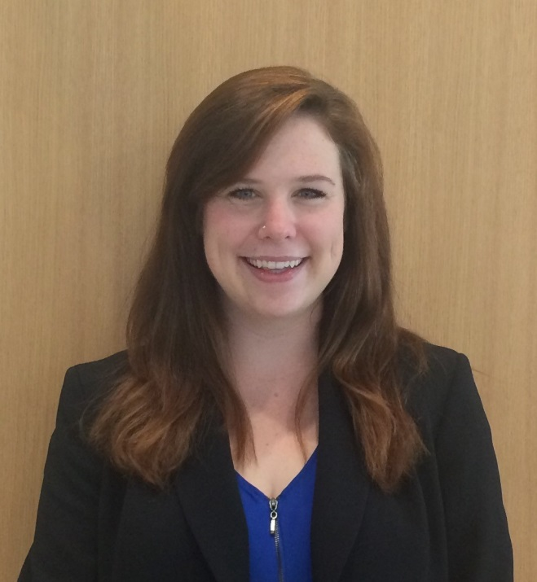
Catherine Ostrowski Martin
This summer, I was able to work at two public service internships in Buffalo, New York, through SPIN. I spent the first half of the summer working at a nonprofit organization, Legal Services for the Elderly, Disadvantaged, and Disabled. I worked primarily in the consumer fraud unit, representing clients who had been scammed out of sometimes thousands of dollars. We worked with their banks and creditors so get some of their debt forgiven and keep them from getting evicted.
The second internship I worked at through SPIN was at the New York State Division of Human Rights. . I worked with an Administrative Law Judge who determined whether Complainants had been discriminated against under the law in the areas of housing, education, and employment. I also got to attend administrative hearings where discrimination determinations were made, and draft opinion letters in the cases.
Legal Services for the Elderly, Disabled and Disadvantaged of Western New York

Slide 11
Amanda Zannoni
My experience at NFHA was inspiring, fulfilling, and sincerely life-changing. It has changed the way I understand race relations, politics, and corporate and commercial economics. As a law clerk I researched these practices extensively and got to see widespread discriminatory practices by corporations and other authorities I never dreamed would be real. It has made me a more well-rounded law student and a more educated American citizen.
Receiving the SPIN Fellowship gave me an opportunity that has literally changed the way I think about the world and inspired me to do more for civil rights and for the public interest. I am grateful to both SPIN and the Syracuse College of Law for this incredible experience.
Legal Intern, National Fair Housing Alliance
Community Programming Director

